Slide 1
MongoDB
Introduction
By Monirul Molla

Slide 2
Overview
In one day:
24 million transactions processed by Walmart
100 TB of data uploaded to Facebook
175 million tweets on Twitter
……….
How to store, query and process these data efficiently?

Slide 3
Overview Continue
The problems with Relational Database:
Overhead for complex select, update, delete operations
Select: Joining too many tables to create a huge size table.
Update: Each update affects many other tables.
Delete: Must guarantee the consistency of data.
Not well-supported the mix of unstructured data.
Not well-scaling with very large size of data.
NoSQL is a good solution to deal with these problems.

Slide 4
Overview Continue
What is NoSQL:
NoSQL = Non SQL or Not only SQL
A NoSQL database provides a mechanism for storage and retrieval of data that is modeled in means other than the tabular relations used in relational databases.

Slide 5
Overview-No SQL Family
2010
1990
2000
RDBMS
Operational Database
NoSQL
RDBMS
Key-Value/
Wide-column
RDBMS
Document DB
Datawarehousing
OLAP/DW
Hadoop
OLAP/DW

Slide 6
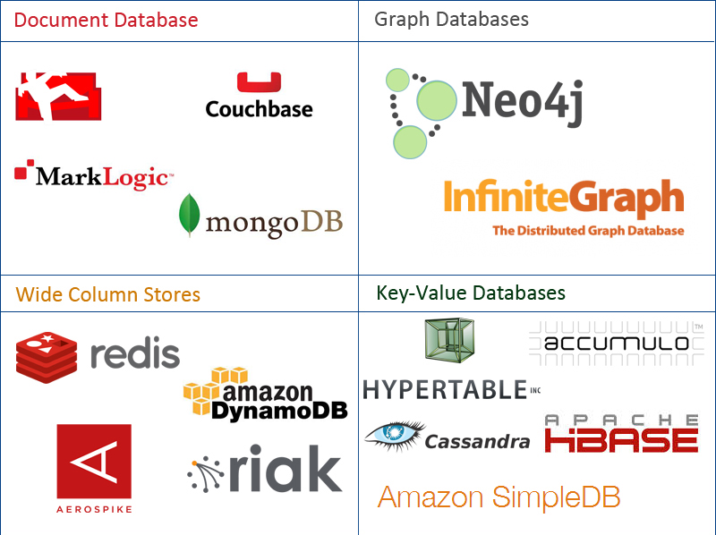
Overview-No SQL Family
Data stored in 4 types:
Document
Graph
Key-value
Wide-column

Slide 7
What is MongoDB?
An open source and document-oriented database
Designed with latest NoSQL theory
Data is stored in JSON-like documents
Designed with both scalability and developer agility.
Dynamic Schemas
Drives innovation
Cost effective
Created 2009

Slide 8
What is MongoDB?
New capabilities
Dynamic and variable schemas
Richly-structured [object] data
Higher performance
Easy horizontal scaling
Low TCO
Traditional capabilities
Rich querying
Strongly consistently data
High availability
Security

Slide 9
Why Use MongoDB?
General Purpose
Rich data model
Full featured indexes
Sophisticated query language
Easy to Use
Easy mapping to object oriented code
Native language drivers in all popular languages
Simple to setup and manage
Fast & Scalable
Operates at in-memory speed wherever possible
Auto-sharding built in
Dynamically add / remove capacity with no downtime

Slide 10
Where to Use MongoDB?
Big Data
Content Management and Delivery
Mobile and Social Infrastructure
User Data Management
Data Hub

Slide 11
SQL Vs MongoDB
SQL Terms/Concepts | MongoDB Terms/Concepts
database | database
table | collection
row | document
column | field
index | index
table joins (e.g. select queries) | embedded documents and linking
Primary keys | _id field is always the primary key
Aggregation (e.g. group by) | aggregation pipeline

Slide 12
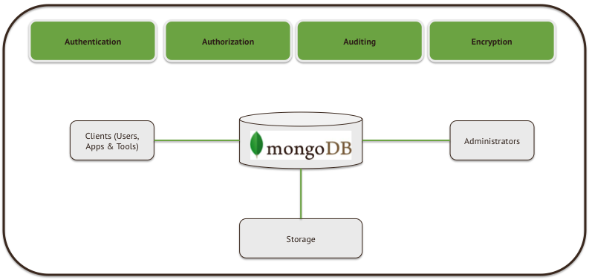
MongoDB-Security Capabalities

Slide 13
MongoDB- Architecture
Application
Dynamic Document
2. Native language drivers
db.customer.insert({…})
db.customer.find({
name: ”John Smith”})
{ name: “John Smith”,
date: “2013-08-01”),
address: “10 3rd St.”,
phone: [
{ home: 1234567890},
{ mobile: 1234568138} ]
}
Driver
Query Router
3. High availability
Replica sets
Shard 1
Shard 2
Shard N
4. High performance
Data locality
Rich Indexes
RAM
Primary
Primary
Primary
…
Secondary
Secondary
Secondary
Secondary
Secondary
Secondary
5. Horizontal scalability
Sharding

Slide 14
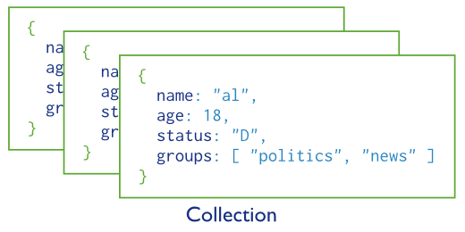
MongoDB- Data Modeling
A collection includes documents.

Slide 15
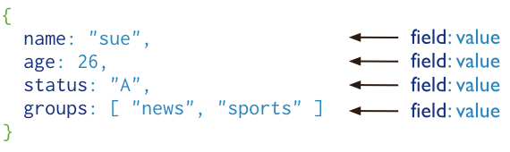
MongoDB- Data Modeling Continue
Structure of a JSON-document:
The value of field:
Native data types
Arrays
Other documents

Slide 16
MongoDB- Data Modeling Continue
Structure of a JSON-document:
The value of field:
Native data types
Arrays
Other documents

Slide 17
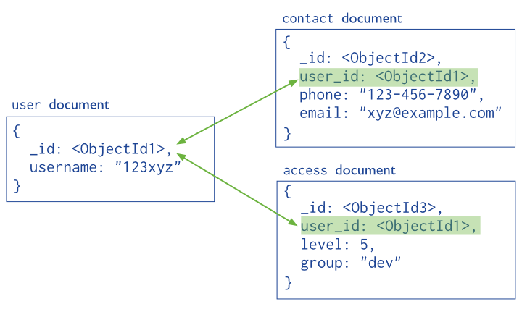
MongoDB- Data Modeling Continue
Reference documents or linking documents

Slide 18
MongoDB- Data Types
Datatype | Description
Double | Used to stored floating point values
String | Commonly used datatype and it is UTF-8 valid
Object | Used for storing embedded objects
Array | Used for storing embedded objects
Binary Data | Used to store binary data
Undefined | Used to store undefined value
Object Id | Used to store document's ID
Boolean | Used to store Boolean value
Date | Used to store current date time in UNIX format.
Null | Used to store null value
Regular Expression | Used to store regex
Javascript | Used to store JavaScript data without scope
Symbol | Basically used to store string, but reserved for languages that use specific symbol
Javascript with scope | Used to store JavaScript data with scope
Integer | Used to store numerical value
Timestamp | Used to track when a document is modified.
Min/Max Key | Used to compare value against lowest and highest BSON elements

Slide 19
Install MongoDB On Windows
Step 1: Download from the following location and install
https://www.mongodb.org/downloads
Step 2: MongoDB requires a data folder to store its files
Default data directory is C:\data\db
Step 3: If we want we can change that data folder to any other location by the following command.
Eg: D:\set up\mongodb\bin>mongod.exe --dbpath “d:\set up\mongodb\data”
Step 4: To start mongo db server
mongod --port 27017 --dbpath C:\data
Step 5: To stop mongo db server
Control-C
Step 6: To use mongo db after the server run
mongo

Slide 20
Install MongoDB On Windows
Step 1: Download from the following location and install
https://www.mongodb.org/downloads
Step 2: MongoDB requires a data folder to store its files
Default data directory is C:\data\db
Step 3: If we want we can change that data folder to any other location by the following command.
Eg: D:\set up\mongodb\bin>mongod.exe --dbpath “d:\set up\mongodb\data”
Step 4: To start mongo db server
mongod --port 27017 --dbpath C:\data
Step 5: To stop mongo db server
Control-C
Step 6: To use mongo db after the server run
mongo

Slide 21
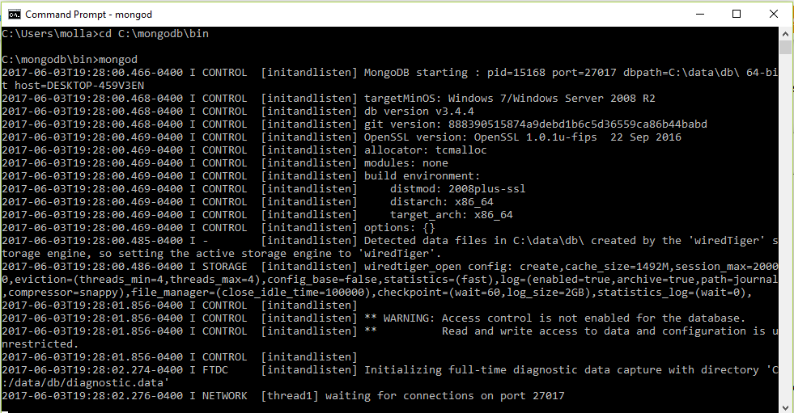
MongoDB- Start Mongo DB
Step 4: To start mongo db server
mongod --port 27017 --dbpath C:\data

Slide 22
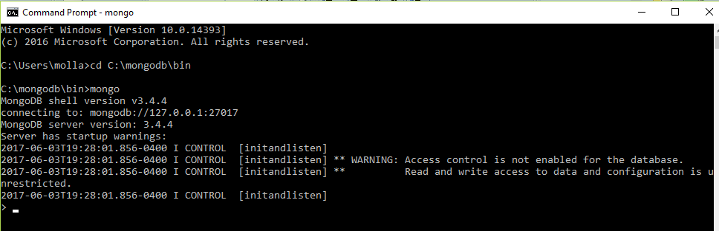
MongoDB- Use Mongo DB after start
Step 6: To use mongo db after the server run use another command prompt and execute mongo
mongo

Slide 23
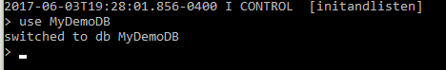
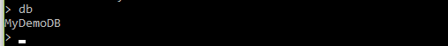
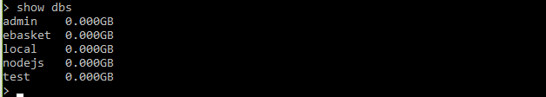
MongoDB- Create & Drop Database
Create new Database MyDemoDB
On type db it will show the current database which you are using.
Show dbs will show all the databases (NB:if we insert a document then it will show)

Slide 24
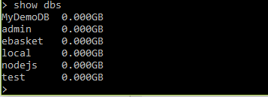
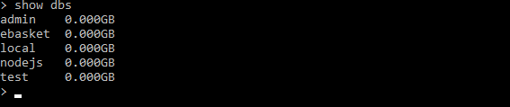
MongoDB- Create & Drop Database Cont.
Now if we show dbs , it will show the dbs
Drop the current table using command “db.dropDatabase()”

Slide 25
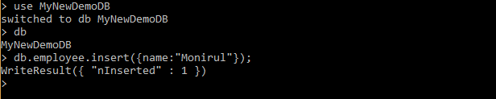
MongoDB- Create & Drop Collection
Two ways of creating collection:
Type 1: Create a collection using command:
db.<collection name>.insert({key:value}); //json object
Type 2 : db.createCollection(name, options)
db.createCollection(“employee1", { capped : true, size : 5242880, max : 5000 } )
To drop a collection in MongoDB simply we need to use following command
db.<collection name>.drop()

Slide 26
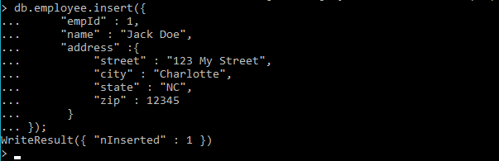
MongoDB- Insert Document
To insert a document in a collection:
db.<collection name>.insert({key:value}); //json object

Slide 27
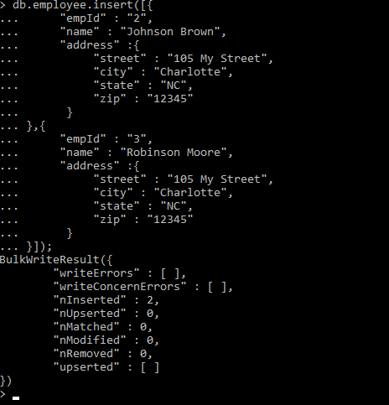
MongoDB- Insert Document Cont..
To insert array of document in a collection:
db.<collection name>.insert([{key:value},{}]); //json object

Slide 28
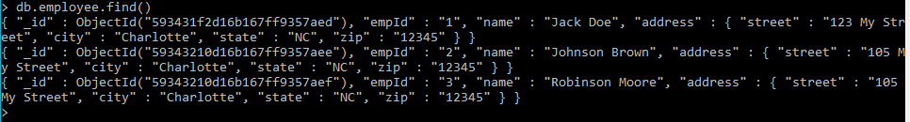
MongoDB- Query Document
To retrieve all the document in a collection:
db.<collection name>.find()
To retrieve a specific document in a collection:
db.<collection name>.find({“key”:”vaue”})
To retrieve document in a collection where name like :
db.<collection name>.find({“key”: /vaue/})
Similarly for start with and end with we can use like this:
db.<collection name>.find({“key”: /^vaue/}) and db.<collection name>.find({“key”: /vaue$/})

Slide 29
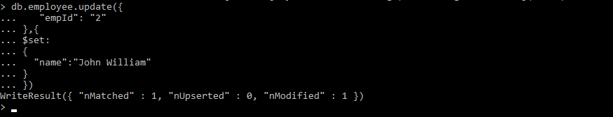
MongoDB- Update Document
To update a document in a collection:
db.<collection name>.update({“key": “value”},{$set:{ “key":“value"}})

Slide 30
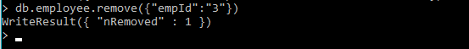
MongoDB- Delete Document
To update a document in a collection:
db.<collection name>.remove({“key": “value”})

Slide 31
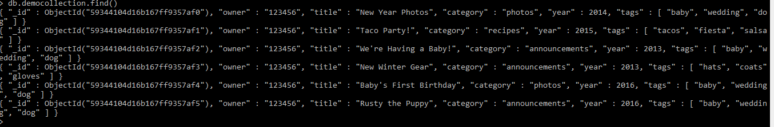
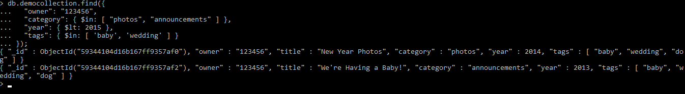
MongoDB- Advance Query
db.democollection.find()
db.democollection.find({
"owner": "123456",
"category": { $in: [ "photos", "announcements" ] },
"year": { $lt: 2015 },
"tags": { $in: [ 'baby', 'wedding' ] }
});

Slide 32
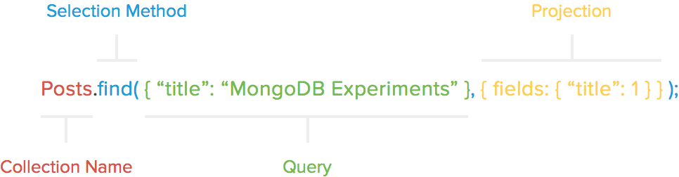
MongoDB- Advance Query & Projection
If we only want to return the title field from the query response and also in sorted order

Slide 33
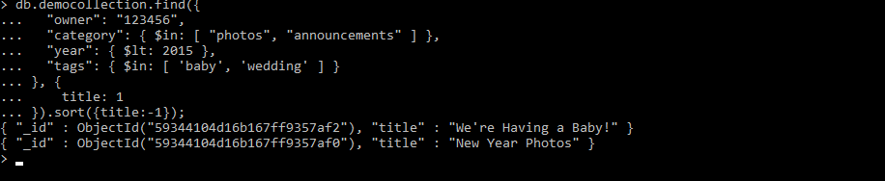
MongoDB- Advance Query & Projection
If we only want to return the title field from the query response and also in sorted order
db.democollection.find({
"owner": "123456",
"category": { $in: [ "photos", "announcements" ] },
"year": { $lt: 2015 },
"tags": { $in: [ 'baby', 'wedding' ] }
}, {
title: 1
}).sort({title:-1});

Slide 34
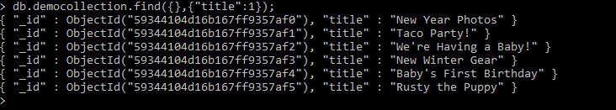
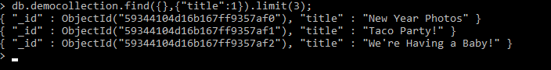
MongoDB- Limiting Records
Limit is an option by which is the number of documents that you want to be displayed.
Two types of limitation:
limit(number)- Number of records to show.
Skip(number)-Number of records not to show.
Normal Query: db.democollection.find({},{"title":1})
Query with limit: db.democollection.find({},{"title":1}).limit(3);

Slide 35
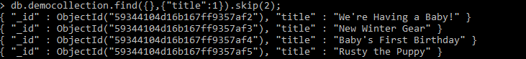
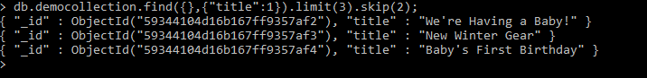
MongoDB- Limiting Records Cont..
Query with skip: db.democollection.find({},{"title":1}).skip(2);
Query with both limit and skip:
db.democollection.find({},{"title":1}).limit(3).skip(2);

Slide 36
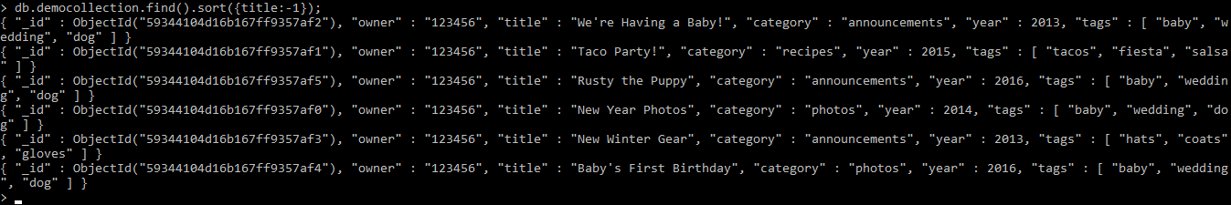
MongoDB- Sorting Records
db.democollection.find().sort({title:-1});

Slide 37
MongoDB- Indexing
a) Provide high performance
b) Provide efficient execution of the queries
c) Prevent scanning of collections
d) Create index to support common and user facing queries.
Index Type | Description
Single field index | Used to create an index on a single field and it can be a user defined as well apart from the default _id one.
Compound index | MongoDB supports the user-defined indexes on multiple fields.
Multi key index | References an array and records a match if a query matches any value in the array.
Geospatial index | Support location based search. Data is stored either GeoJson objects or coordinate pairs
Text index | This index is used to search for a string content in a collection
Hashed index | Used for hash based Sharding

Slide 38
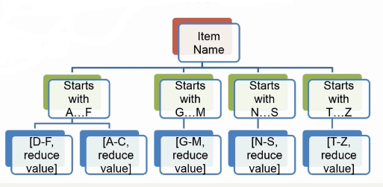
MongoDB- Indexing
a) Store a small portion of the collections data set
b) Stores the values of specific fields, order by value
c) Can return sorted result directly from the index
d) Can return result without scanning any document
e) Use B-Tree index

Slide 39
MongoDB- Index Properties
TTL-
=>Used to automatically remove after certain period of time
=>Good for event logs and session information.
b) Unique-
=>Separate document contain duplicate values for the index field are rejected in
collection
=>When use compound index , uniqueness is the combination of the values of
the document.
=>Only one document in a collection can have NULL stored as an index field
Cannot be specified on hashed index
c) Sparse
=> Contain entries for documents with an indexed field, even if it is NULL
=> Can have sparse and unique index

Slide 40
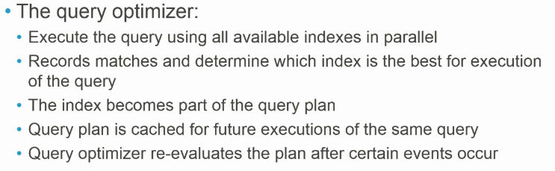
MongoDB- Index & Query Optimization

Slide 41
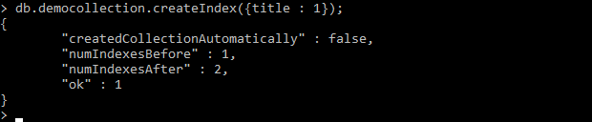
MongoDB- Indexing Cont..
To create an index in MongoDB, run the following command :
db.<collection name>.createIndex({field : value })
db.democollection.createIndex({title : 1});

Slide 42
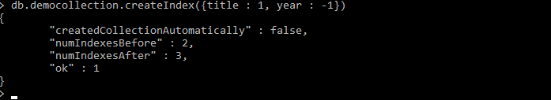
MongoDB- Indexing Cont..
Index on multiple fields by running a single command :
db.<collection name>.createIndex({field1 : value , field2:value })
db.democollection.createIndex({title : 1, year : -1})

Slide 43
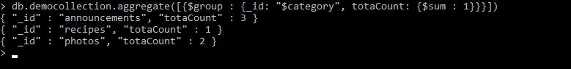
MongoDB- Aggregation
Aggregation basically groups the data from multiple documents and operates in many ways on those grouped data in order to return one combined result.
group by is an equivalent of MongoDB aggregation.
Following is the syntax for aggregation :
db.<collection name>.aggregate(aggregate_operation)
db.democollection.aggregate([{$group : {_id: "$category", totaCount: {$sum : 1}}}])

Slide 44
MongoDB- Aggregation Cont..
Different expressions used by Aggregate function
Expression | Description
$sum | Summates the defined values from all the documents in a collection
$avg | Calculates the average values from all the documents in a collection
$min | Return the minimum of all values of documents in a collection
$max | Return the maximum of all values of documents in a collection
$addToSet | Inserts values to an array but no duplicates in the resulting document
$push | Inserts values to an array in the resulting document
$first | Returns the first document from the source document
$last | Returns the last document from the source document

Slide 45
MongoDB- Replication
Replication is the process of synchronizing data across multiple servers.
Why Replication?
To keep your data safe
High (24*7) availability of data
Disaster recovery
No downtime for maintenance (like backups, index rebuilds, compaction)
Read scaling (extra copies to read from)
Replica set is transparent to the application

Slide 46
MongoDB- Replication Cont..
How Replication Works in MongoDB
MongoDB achieves replication by the use of replica set
Replica set is a group of two or more nodes (generally minimum 3 nodes are required).
In a replica set, one node is primary node and remaining nodes are secondary.
All data replicates from primary to secondary node.
At the time of automatic failover or maintenance, election establishes for primary and a new primary node is elected.
After the recovery of failed node, it again join the replica set and works as a secondary node.
Set Up a Replica Set
mongod --port "PORT" --dbpath "YOUR_DB_DATA_PATH" --replSet "REPLICA_SET_INSTANCE_NAME"
Example: mongod --port 27017 --dbpath "D:\set up\mongodb\data" --replSet rs0
Add Members to Replica Set
>rs.add(HOST_NAME:PORT)
Example :>rs.add("mongod1.net:27017") >

Slide 47
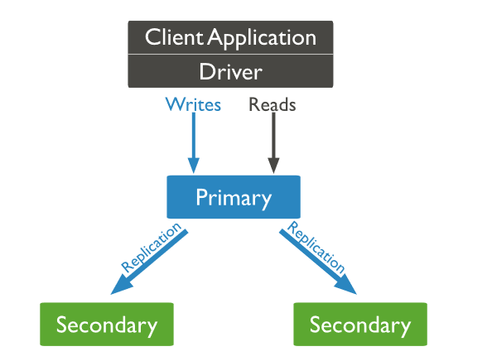
MongoDB- Replication Cont..

Slide 48
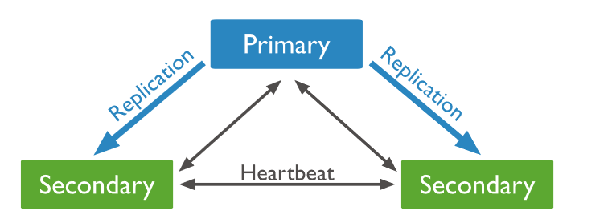
MongoDB- Replication Cont..

Slide 49
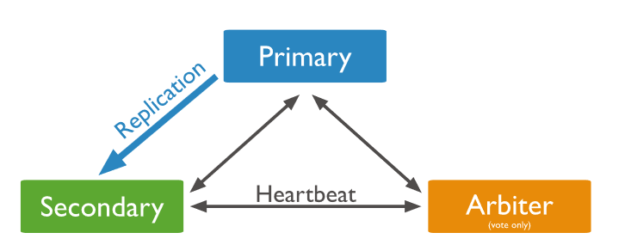
MongoDB- Replication Cont..

Slide 50
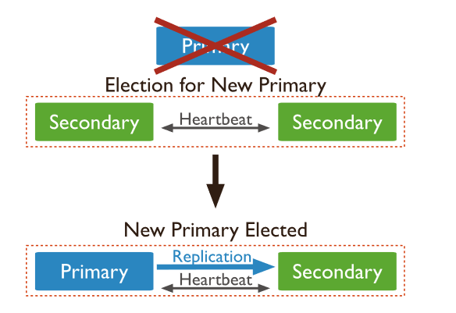
MongoDB- Replication Cont..

Slide 51
MongoDB- Sharding
Sharding is the process of storing data records across multiple machines
Why Sharding?
In replication, all writes go to master node
Latency sensitive queries still go to master
Single replica set has limitation of 12 nodes
Memory can't be large enough when active dataset is big
Local disk is not big enough
Vertical scaling is too expensive

Slide 52
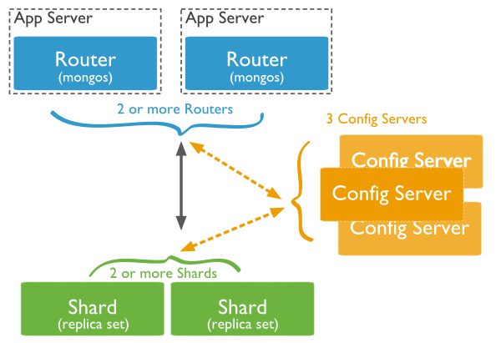
MongoDB- Sharding

Slide 53
Global Deployment with Local Read/Writes
Primary:LON
Secondary:NYC
Primary:NYC
Secondary:SYD
Secondary:LON
Secondary:SYD
Primary:SYD
Secondary:LON
Secondary:NYC

Slide 54
Jasmine Js
Introduction
By Monirul Molla

Slide 55
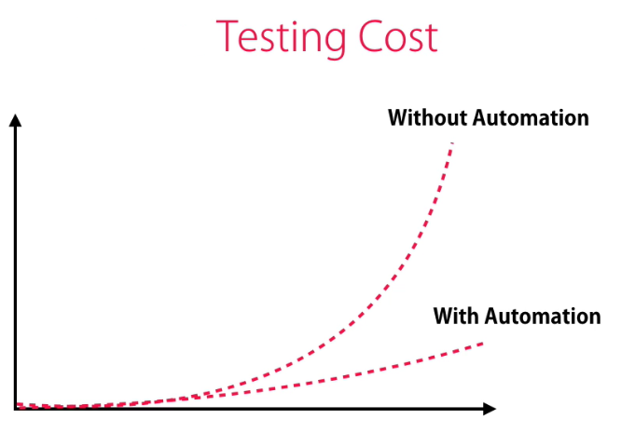
Jasmine- Introduction

Slide 56
What is Jasmine Js?
Open Source
Javascript Framework
Most Popular
Simple API
Behavior Driven Development (BDD) Pocedure.

Slide 57
Why Use Jasmine?
Jasmine does not depend on any other JavaScript framework
Jasmine does not require any DOM
All the syntax used in Jasmine framework is clean and obvious
Jasmine is heavily influenced by Rspec, JS Spec, and Jspec
Jasmine is an open-source framework and easily available in different versions like stand-alone, ruby gem, Node.js, etc

Slide 58
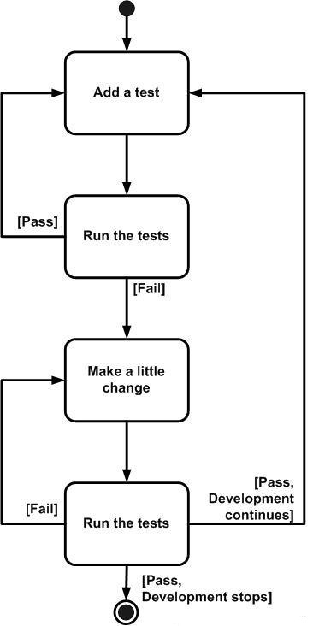
Test Driven Development (TDD) framework

Slide 59
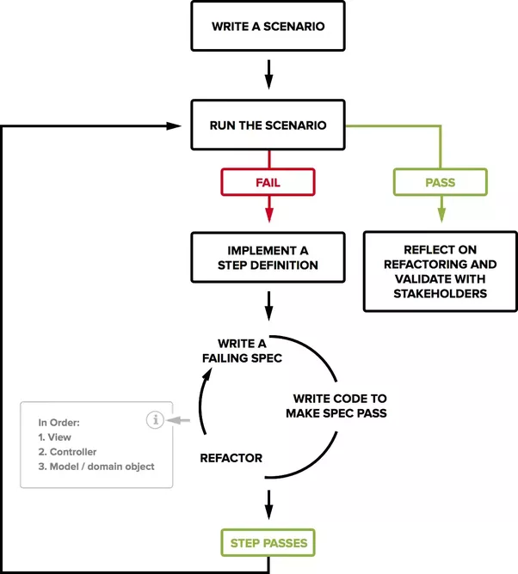
Behavioral Driven Development (BDD) framework

Slide 60
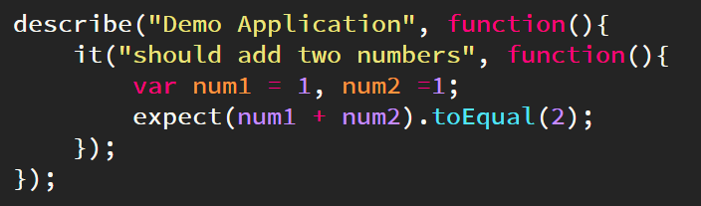
Jasmine- Building blocks
Suite : to describe a section of your code
Specs: it creates a new spec
Expectations : what you expect the code block to do
Matchers : utility functions
toEqual
toMatch
toBeTruthy
And lot’s more to list here..

Slide 61
Jasmine- AAA (Arrange Act Assert)
import { VoteComponent } from './vote.component'; describe('VoteComponent', () => { it('should increment totalVotes when upvoted', () => { // Arrange const component = new VoteComponent(); // Act component.upVote(); // Assert expect(component.totalVotes).toBe(1); }); });

Slide 62
Jasmine- Skip Block
Skipping Spec
xit() –To excape a spec
Skipping Suite
xdescribe() –To escape a suite

Slide 63
Jasmine- Equality Check
scenarios/01-equality-check/compute.spec.ts
toEqual()
const result = compute(-1); expect(result).toEqual(0);
not.toEqual()
const result = compute(-1); expect(result).not.toEqual(2);
toBe()
const result = compute(1); expect(result).toBe(2);
not.toBe()
const result = compute(1); expect(result).not.toBe(0);

Slide 64
Jasmine- Boolean Check
scenarios/02-boolean-check/compute.spec.ts
toBeTruthy()
it('should return true if it is positive', () => { const result = compute(1); expect(result).toBeTruthy(); });
toBeFalsy()
it('should return false if input is negative', () => { const result = compute(-1); expect(result).toBeFalsy(); });

Slide 65
Jasmine- Sequential Check
scenarios/03-sequential-check/greet.spec.ts
toContain()
it('should contain name in the message', () => { expect(greet('John')).toContain('John'); });
toBeCloseTo()
it('Example of toBeCloseTo()', function (){ expect(12.34).toBeCloseTo(12.3, 1); });
toMatch()
it('Example of toMatch()', function (){ expect('www.jasmine.com').toMatch(/com/); });

Slide 66
Jasmine- Null Check
scenarios/04-null-check/nullcheck.spec.ts
toBedefined()
it('Example of toBeDefined', function (){ expect(currentVal).toBeDefined(); });
toBeUndefined()
it('Example of toBeUndefine()', function (){ expect(undefinedValue).toBeUndefined(); });
toBeNull()
it('Example of toBeNull()', function (){ expect(nullValue).toBeNull(); });

Slide 67
Jasmine- Inequality Check
scenarios/05-inequality-check/inequalitycheck.spec.ts
toBeGreaterThan()
it('Example of toBeGreaterThan()', function (){ expect(myValue).toBeGreaterThan(5); });
toBeLessThan()
it ('Example of toBeLessThan()' , function (){ expect(myValue).toBeLessThan(10); });

Slide 68
Jasmine- Not a number check
scenarios/06-not-a-number-check/notanumber.spec.ts
toBeNaN()
it('Example of toBeGreaterThan()', function (){ expect(myValue).toBeGreaterThan(5); });

Slide 69
Jasmine- Exception Check
scenarios/07-exception/exception.ts
export function myException() { throw new Error(); }
scenarios/07-exception/exception.spec.ts
import {myException} from './exception'; describe('Error Block', function() { it ('Hey this will throw an Error', function() { expect(myException).toThrow(); }); });

Slide 70
Jasmine- Before & After call.
scenarios/08-before-after/beforeafter.spec.ts
let currentval = 0; beforeEach(function(){ currentval = 5; }); afterEach(function(){ currentVal = 10; });
beforeEach(() => { }); afterEach(() => { }); beforeAll(() => { }); afterAll(() => { });

Slide 71
Jasmine- Spies
spyOn()
describe('Example Of jasmine Spy using spyOn()', function() { it('uses the dictionary to say "hello world', function() { const dictionary = new Dictionary; const person = new Person; spyOn(dictionary, 'hello'); // replace hello function with a spy spyOn(dictionary, 'world'); // replace world function with another spy person.sayHelloWorld(dictionary); expect(dictionary.hello).toHaveBeenCalled(); // not possible without first spy expect(dictionary.world).toHaveBeenCalled(); // not possible withoutsecond spy }); });

Slide 72
Jasmine- Spies Cont..
createSpy()
describe('Example Of jasmine Spy using Create Spy', function() { it('can have a spy function', function() { const person = new Person(); person.getName11 = jasmine.createSpy('Name spy'); person.getName11(); expect(person.getName11).toHaveBeenCalled(); }); });

Slide 73
Jasmine Demo 1 - Fundamental
package.json
"devDependencies": { "@angular/compiler-cli": "^2.3.1", "@types/jasmine": "2.5.38", "@types/node": "^6.0.42", "angular-cli": "1.0.0-beta.26", "codelyzer": "~2.0.0-beta.1", "jasmine-core": "2.5.2", "jasmine-spec-reporter": "2.5.0", "karma": "1.2.0", "karma-chrome-launcher": "^2.0.0", "karma-cli": "^1.0.1", "karma-jasmine": "^1.0.2", "karma-remap-istanbul": "^0.2.1", "protractor": "~4.0.13", "ts-node": "1.2.1", "tslint": "^4.3.0", "typescript": "~2.0.3" }

Slide 74
Jasmine Demo 1 – Fundamental Cont..
compute.ts
export function compute(number) { if (number < 0) { return 0; } return number + 1; }
Compute.spec.ts
import {compute} from './compute'; describe('compute', () => { it('should return 0 if input is negative', () => { const result = compute(-1); expect(result).toBe(0);//success scenario }); })

Slide 75
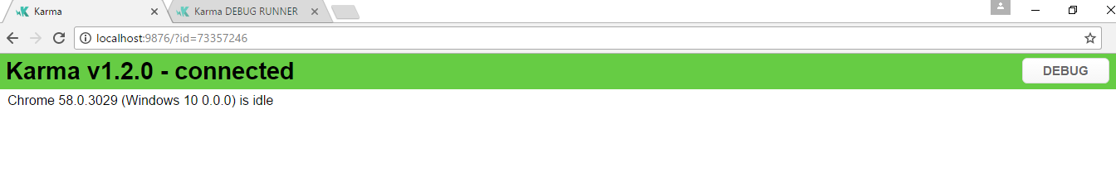
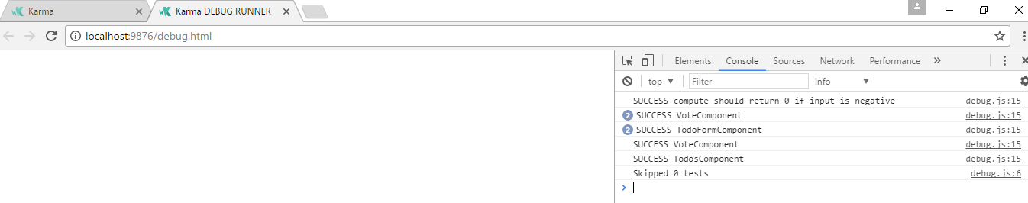
Jasmine Demo 1 – Fundamental Cont..
On npm test, it will start the karma server and open the chrome browser
Success Scenario:: SUCCESS compute should return 0 if input is negative
expect(result).toBe(0);//success scenario

Slide 76
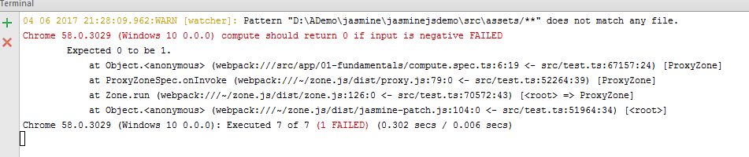
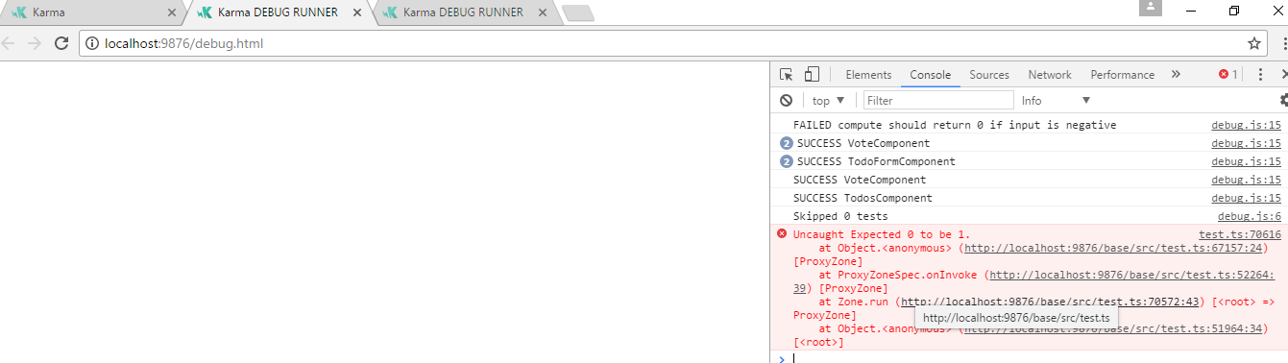
Jasmine Demo 1 – Fundamental Cont..
Failure Scenario:: SUCCESS compute should return 0 if input is negative
expect(result).toBe(1);
At Terminal Console
At Chrome Browser

Slide 77
Jasmine Demo 2 –String
greet.ts
export function greet(name) { return 'Welcome ' + name; }
greet.spec.ts
import {greet} from './greet'; describe('greet', () => { it('should include name in the message', () => { // expect(greet('Monirul')).toBe('Welcome Monirul'); expect(greet('Monirul')).toContain('Monirul'); }); });

Slide 78
Jasmine Demo 3 –Array
getCurrencies.ts
export function getCurrencies() { return ['USD', 'AUD', 'EUR']; }
getCurrencies.spec.ts
import {getCurrencies} from './getCurrencies'; describe('getCurrencies', () => { it('should return the supported currencies', () => { const result = getCurrencies(); expect(result).toContain('USD'); expect(result).toContain('AUD'); expect(result).toContain('EUR'); }); });

Slide 79
Jasmine Demo 4 –Setup and Test Component
VoteComponent.ts
export class VoteComponent { totalVotes = 0; upVote() { this.totalVotes++; } downVote() { this.totalVotes--; } }
VoteComponent.spec.ts
import { VoteComponent } from './vote.component'; describe('VoteComponent', () => { it('should increment totalVotes when upvoted', () => { // Arrange const component = new VoteComponent(); // Act component.upVote(); // Assert expect(component.totalVotes).toBe(1); }); it('', () => { }); });

Slide 80
Jasmine Demo 4 –Setup and Test Component
VoteComponent.ts
export class VoteComponent { totalVotes = 0; upVote() { this.totalVotes++; } downVote() { this.totalVotes--; } }
VoteComponent.spec.ts
import { VoteComponent } from './vote.component'; describe('VoteComponent', () => { it('should increment totalVotes when upvoted', () => { // Arrange const component = new VoteComponent(); // Act component.upVote(); // Assert expect(component.totalVotes).toBe(1); }); it('', () => { }); });

Slide 81
Jasmine Demo 5 –Forms input testing
todo-form.component.ts
import { FormBuilder, Validators, FormGroup } from '@angular/forms'; export class TodoFormComponent { form: FormGroup; constructor(fb: FormBuilder) { this.form = fb.group({ name: ['', Validators.required], email: [''], }); } }
todo-form.component.spec.ts
import {FormBuilder} from '@angular/forms'; import { TodoFormComponent } from './todo-form.component'; describe('TodoFormComponent', () => { let component: TodoFormComponent; beforeEach(() => { component = new TodoFormComponent(new FormBuilder()); }); it('should create a form with two fields', () => { expect(component.form.contains('name')).toBe(true); expect(component.form.contains('email')).toBe(true); }); it('should make the name field required', () => { const control = component.form.get('name'); control.setValue(''); expect(control.valid).toBe(false); }); });

Slide 82
Jasmine Demo 6 –Event Emitter Testing
vote.component.ts
import { EventEmitter } from '@angular/core'; export class VoteComponent { totalVotes = 0; voteChanged = new EventEmitter(); upVote() { this.totalVotes++; this.voteChanged.emit(this.totalVotes); } }
vote.component.spec.ts
import { VoteComponent } from './vote.component'; describe('VoteComponent', () => { let component: VoteComponent; beforeEach(() => { component = new VoteComponent(); }); it('should raise voteChanged event when upVoted', () => { let totalVotes = null; component.voteChanged.subscribe(tv => totalVotes = tv); component.upVote(); //expect(totalVotes).not.toBeNull(); expect(totalVotes).toBe(1); }); });

Slide 83
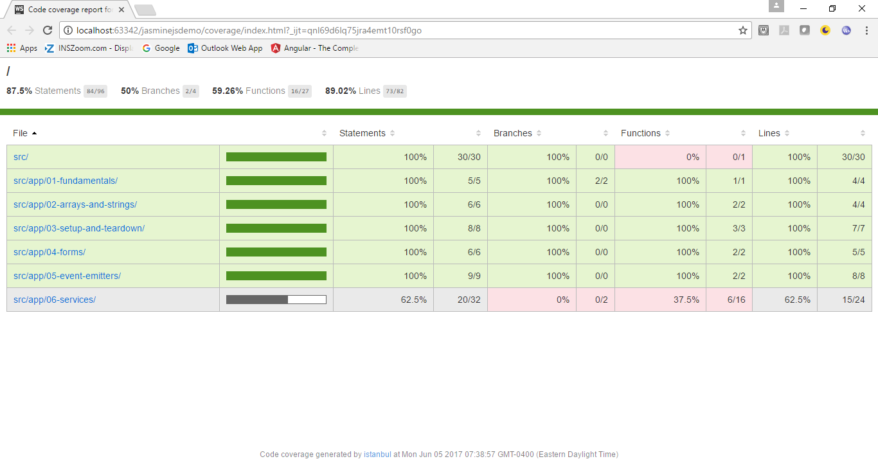
Jasmine –Code Coverage
ng test --code-coverage

Slide 84
Thank You

